Slide 1

Wireless network connection
By
Zahir Yousafzai
Aditya Venkatesh Annavarapu
IS 620
Prof: Dr. Huei Lee

Slide 2
Wireless Home Network Connection
Wireless Terms and Jargons
WLAN
Wi-Fi
802.11a/802.11b/802.11g
WEP/WPA
Types of Wireless Equipment
Installing and Configuring WLAN
Router installation
Connect the router to modem
Configuring the Router
Enter your Internet connection information

Slide 3
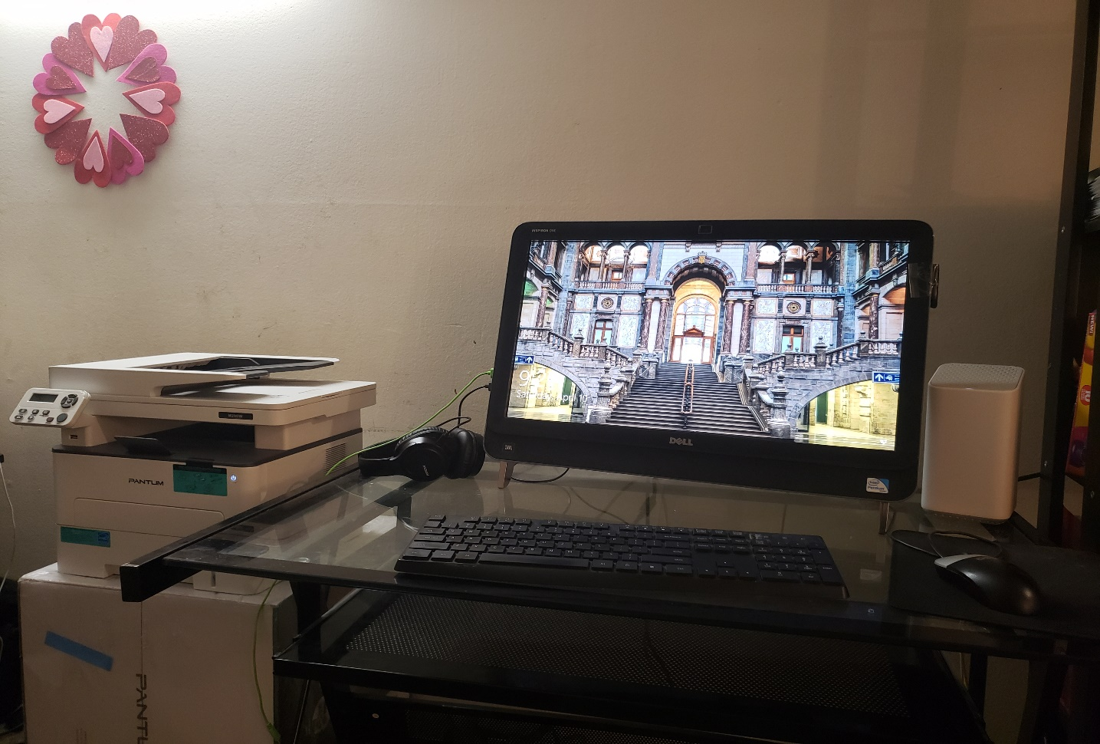
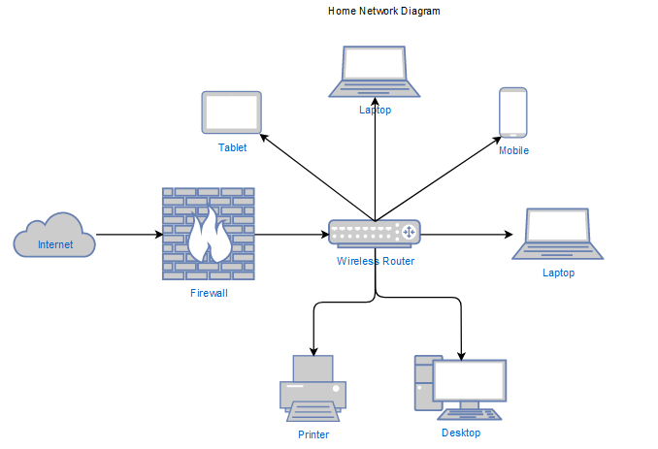
Home Network Diagram

Slide 4
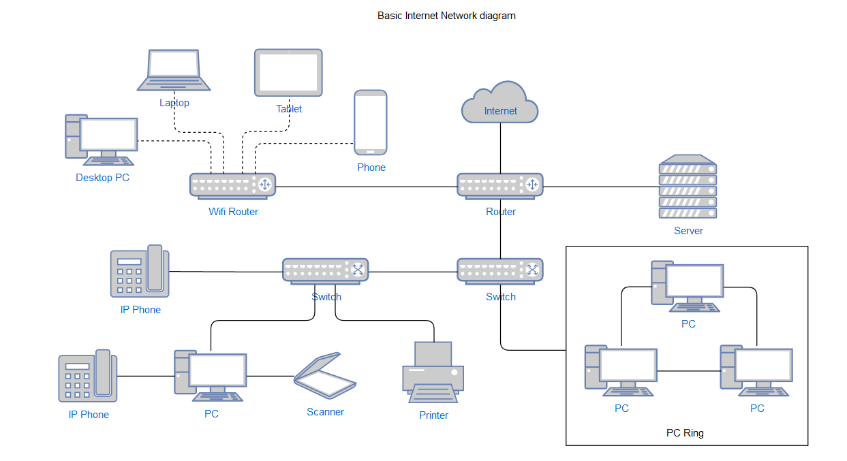
Design of LAN for a Local Home Healthcare Business with administration for Multiple Users

Slide 5
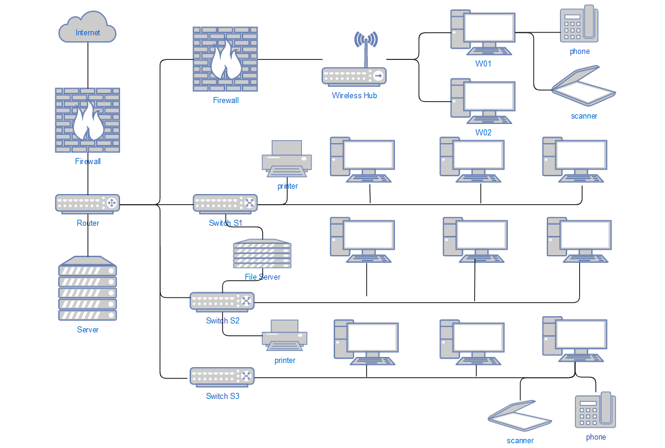
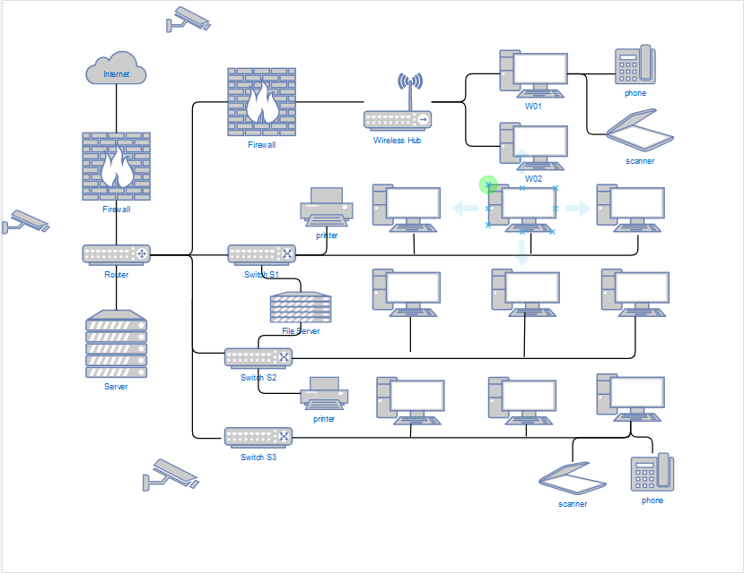
Office Network Diagram

Slide 6
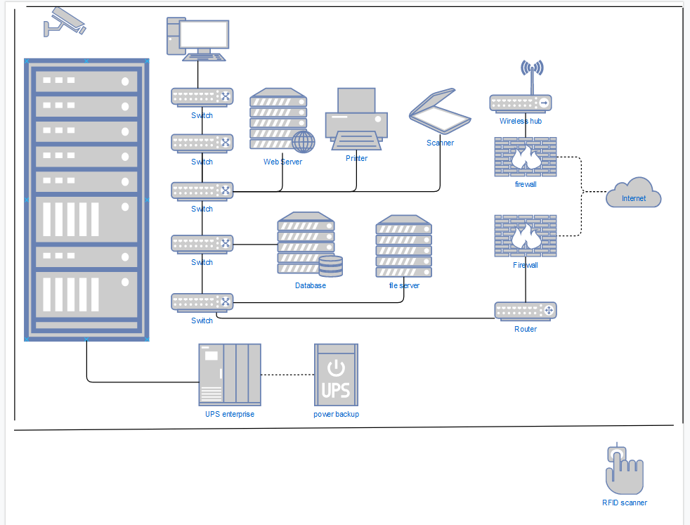
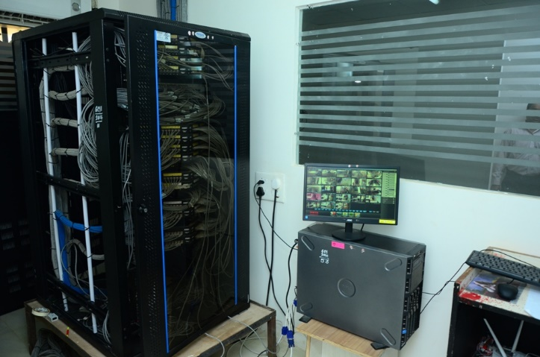
Server Room

Slide 7
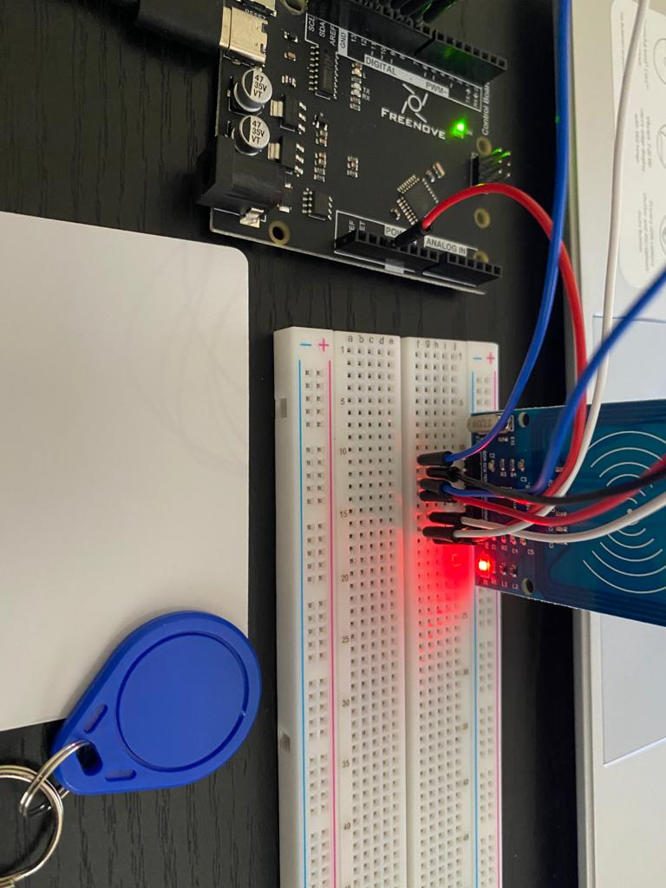
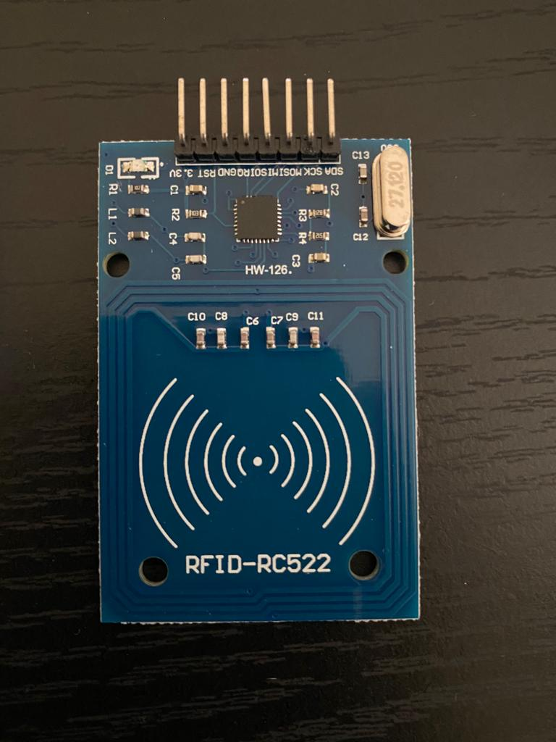
Server Room Access using RFID tags prototype
RFID Tags
RFID Reader

Slide 8
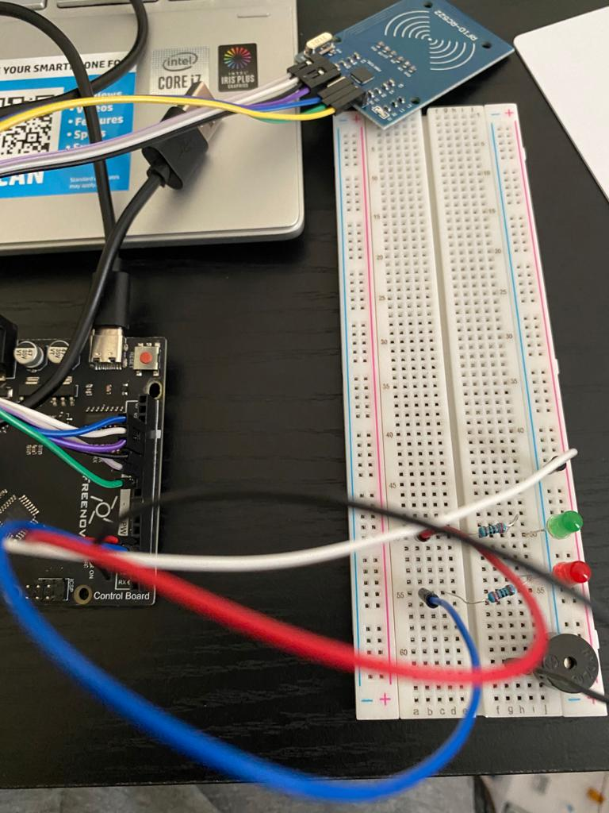
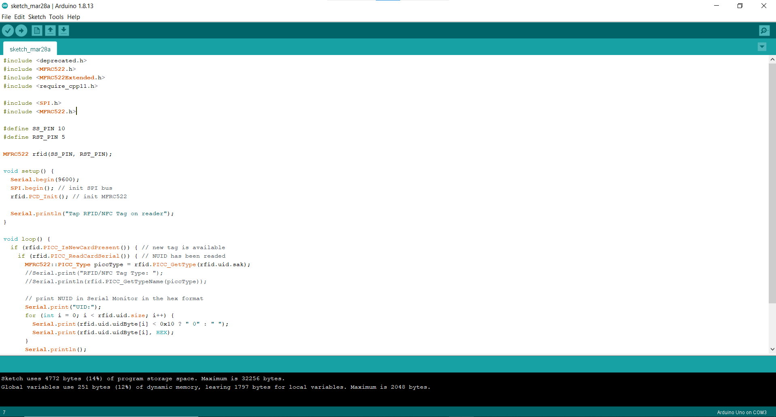
RFID Circuit
Coding

Slide 9
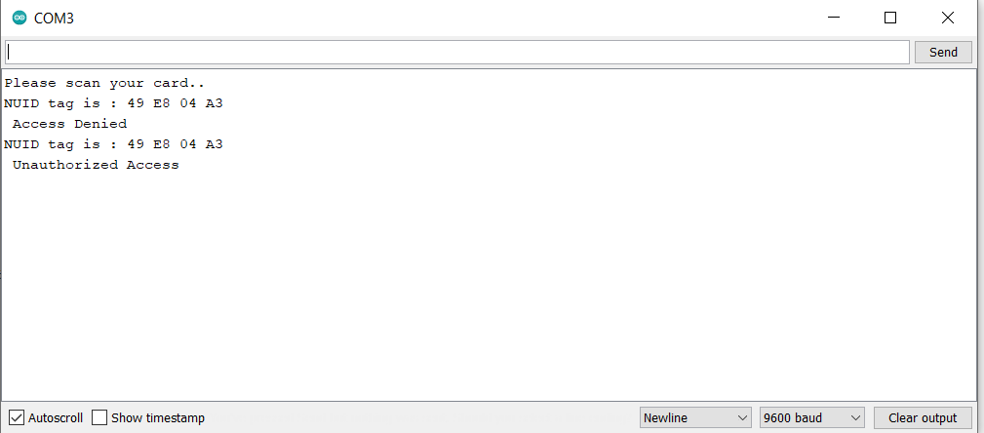
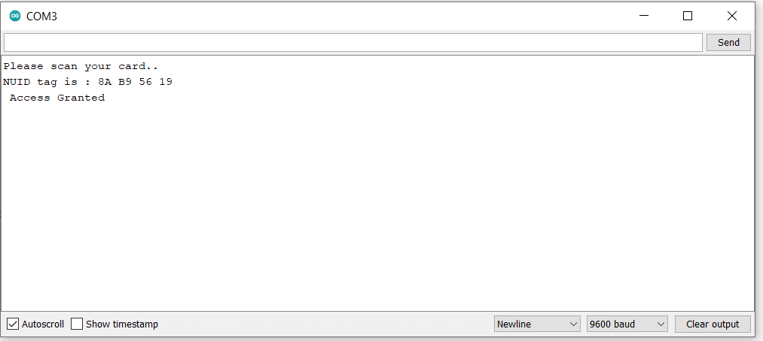
Access Denied
Access Granted

Slide 10
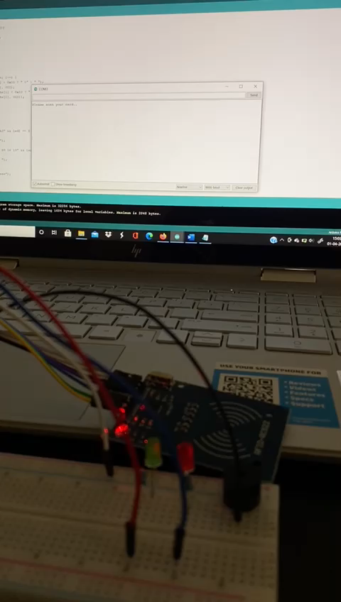
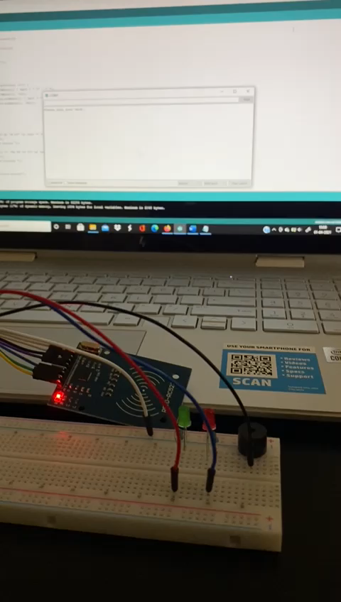
Access Granted
Access Denied and Unauthorized access

Slide 11


